Slide 1

The Symbiotic Nature of Zero Rate Policy, the Real Economy and the Asset Markets
Term Paper ME2720
Patrick Truong

Slide 2
Background
Very volatile market today.
Many prominent investors believe asset prices have been distorted by fiscial policy – QE, ZIRP, NIRP.
Forcing all investors to take on assets as alternative to debt securities.
Fundamentally the world economy is ok, besides
Slowdown in Chinese economy – not surprising given high growth period. (Irwin 2014)
Internally doing well (Yuzhakov 2016)
Low commodity prices.
Strain in emerging markets.

Slide 3

Problem Description
Investigating how ZIRP influences the asset markets today.
Does QE help and is ZIRP a sustainable solution?
Investigating how the asset market influences the real economy.

Slide 4
Method
Litterature study to establish current research within subject.
Data analysis of GDP and assets (housing and equity markets).
Monthly time series of Swedish GDP, housing price index (HOX), repo rate and CPI between 2005-2016.
Monthly time series of US real GDP, housing price index (Case-Schiller), FED rate and PB-ratio.
All data normalised with base from 2005 and 2009.
Adjusting for Great Financial Crisis (2008).
Data from Statistiska Central Bryån, Valueguard and Multpl.
Data processed with Python and Excel, and analysed with Python and R.

Slide 5
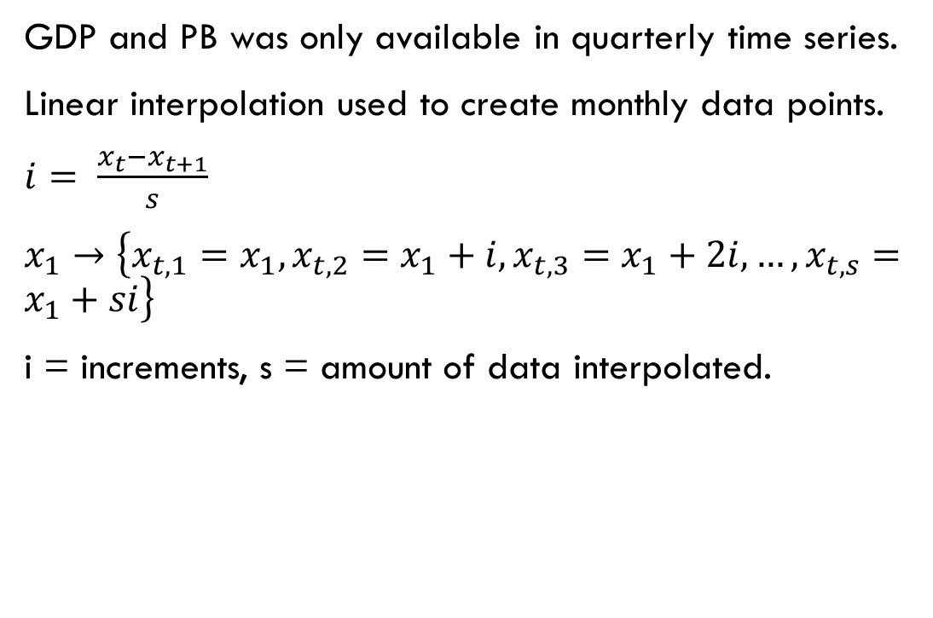
Method – Data processing
import csv
#READ IN FILES
rawdata = []
with open('BNPSverige.csv') as csvfile:
reader = csv.reader(csvfile, delimiter = ";")
for row in reader:
rawdata.append(row)
#LINEAR INTERPOLATION FUNCTION
def LinearInt(datalist, i,step):
try:
diff = float(datalist[i+1][1])-float(datalist[i][1])
inc = diff/step
except:
inc = 0
return inc, step
#FILL DATA LIST WITH INTERPOLATED DATA
IntData=[]
for i in range(len(rawdata)):
inc, step = LinearInt(rawdata,i,3)
for j in range(step):
IntData.append(float(rawdata[i][1])+j*inc)
#IF NECESSARY REVERSE DATA
ReverseIntData=[]
REVERSE ORDER FOR US
for i in reversed(IntData):
print(i)
GDP and PB was only available in quarterly time series.
Linear interpolation used to create monthly data points.
$i= \frac{x_{t}−x_{t+1}}{s}$
$x_{1}→\left\{x_{t,1}=x_{1},x_{t,2}=x_{1}+i,x_{t,3}=x_{1}+2i,…,x_{t,s}=x_{1}+si\right\}$
i = increments, s = amount of data interpolated.

Slide 6

Method – Data processing (cont.)
To determine the relationship between asset markets and real economy.
Correlation matrix and scatter plot.
Literature study.
To determine zero rate policy influence on asset prices.
Regression
$$ρ= \frac{\left.Cov(a,b\right)}{σ_{a}∗σ_{b}}$$

Slide 7
Previous Studies – Quantitative easing
Zero Lower Bound should occur relatively frequently.
With standard inflation target of 2 %, the FED rate should be zero 5 % of the time and a typical ZLB period should be four quarters. (Taylor 1993)
A ZIRP period should be economically insignificant if inflation target is set above 1 % or higher (ECB working paper 2003, Schmitt-Grohé & Uribe 2005).
ZIRP is needed to restore market equilibrium (Reifschneider & Williams 2000)
ZIRP implies small stabilization costs for better real economy.
→ ZIRP good for real economy → good for asset market

Slide 8
Previous study - Quantitative easing (cont.)
Many researchers believe QE is working.
However the current ZIRP has lasted from december 2008 – much longer than previous episodes on which research is conducted.
Chung et al. (2012) Critizises previous researches.
Previous research do not account for tail-events.
Previous research are anchored to previous events.
Previous research have not sufficiently analyzed consequenses of prolonged ZLB periods (like our current situation).
QE improve macro conditions – but what about effects on employment and inflation?
→ ZLB thoroughly researched however limitation to previous research mean we cannot conclude much from them.

Slide 9

Previous Study – Asset inflation (Equity)
QE significantly contribute to increases in stock market, but do significantly less to contribute to long-term interest rates and unemployment. (Bhar et al. 2015, Kiley 2014)
Adds value to stocks but not real-economy.

Slide 10
Previous Study – Asset inflation (Housing)
Growth in housing prices can result as economic growth persist, even without population growth (Leung 2003, Claussen 2013).
However growth beyond a certain fraction of economic growth is not sustainable.
Main reason - Increased disposable income and falling mortgage rate.
Clear negative relationship between housing prices and interest rate ( Nissim 2012)
Uncertainty contribute to increasing housing prices (Hirata et al. 2012)
Increasing volatility in stock market turn people to shift towards safer assets, suhc as housing.
Assets co-move in pricing – long-term equilibrium. (Yang 2005)
Results might be explained by general optimism → all assets appreciate in value.
While reducing policy rates increase housing prices, increasing them do not depress housing prices (Shi et al. 2014) → risk for housing bubble.
However → No bubble (Claussen 2013)
So while QE might inflate housing prices, only market forces can depress them.
Explained by Endowment effect.

Slide 11
Previous Study – Asset market influence on real economy
Real economy has more pronounced effect on stock market than vice versa (Fraser 2006).
Also that shocks that influence real economu is less important than stock market dynamics.
Countries with well functioning stock market grows significantly faster than those without (Ngare 2014)
Stock market functions as a medium to distribute capital from those in search of investment opportunities to those with business ideas in need of capital.
Real positive effect on economy.
More pronounced in less developed countries because much of the stock market activity is of second-hand nature in developed countries.

Slide 12
Previous Study – Asset market influence on real economy (cont.)
Stock value increase leads to increased wealth and consumption (Poterba 2000)
Strong stock market induces consumer confidence – boosts consumption from all segments in society.
Increase in housing also contribute to consumer confidence (Zhou et al. 2016)
However housing prices decreases consumption power of those outside the housing market wanting to get in.
The net effect of housing prices is negative.
Many other researchers confirm findings.

Slide 13
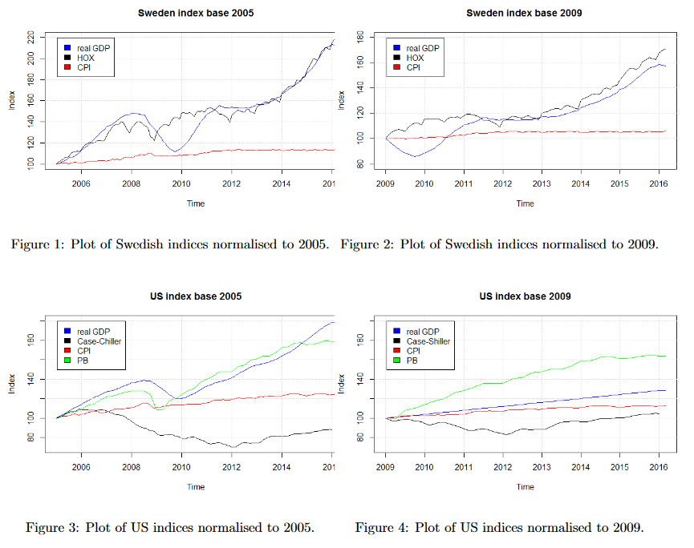
Results

Slide 14
Results
Clear correlation between the Swedish housing market and real GDP for both base years.
No housing bubble.
However people are spending all thier earnings increase on housing rather than consumption (flat CPI curve).
US Housing prices depressed in comparison to how real economy has evolved.
Significant equity overvaluation if using 2009 as base year.
Stock market correction if using 2005 as base year.

Slide 15
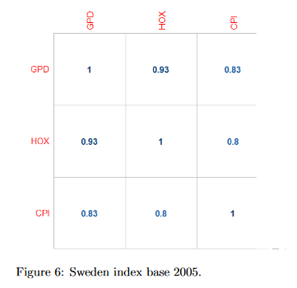
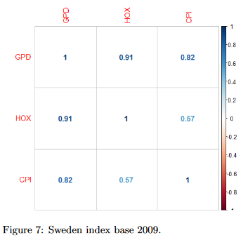
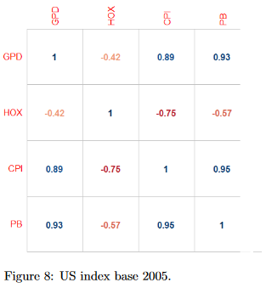
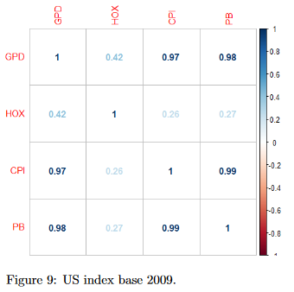
Results
Near perfect correlation between
GDP and housing prices in Sweden.
GDP and equity market in US.

Slide 16
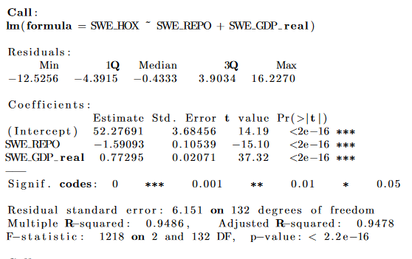
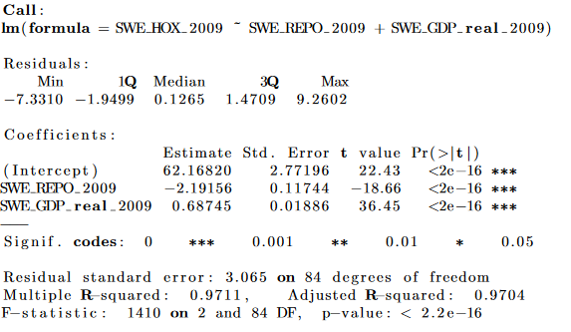
Results – Housing SWE
High R2 on both 2005 and 2009 models.
Indicates negative relationship between housing and repo rate.

Slide 17
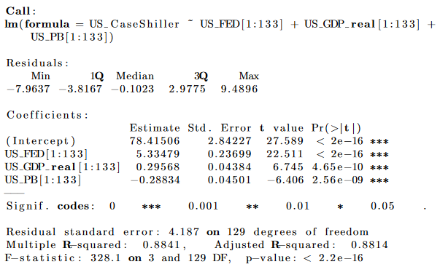
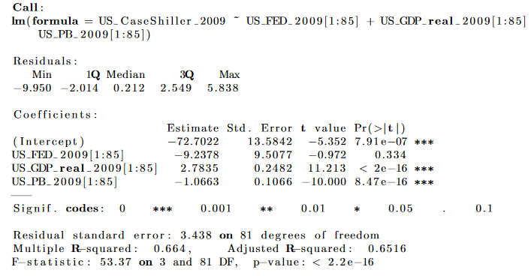
Result – Housing US
High R2
2005: FED positive impact on Case-Shiller
Due to CDO and insensitive housing market.
2009: FED negative impact on Case-Shiller
PB negative impact on housing market.

Slide 18
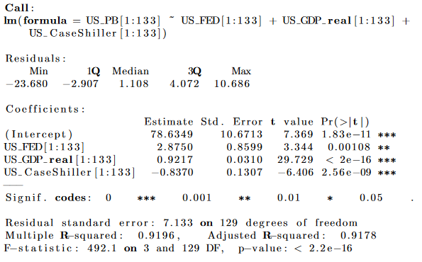
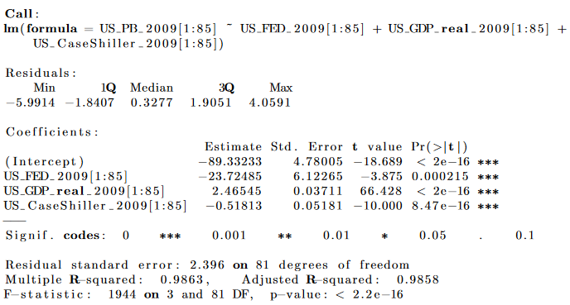
Results – Equity US
High R2
2005: FED positive impact on stocks
Optimism and overconfidence in market – market insensitivity.
2009: FED negative impact on stocks

Slide 19
Conclusion of previous study
ZIRP likely have positive influence on real economy
QE causes unhealthy asset inflation.
Wealth increase only for those benefiting from it.
”Endowment effect”
Asset market influence the real economy indirectly.
Through stock market wealth increase.
Consumer confidence.
ZIRP have negative correlation with stock and house pricing
Asset inflate the same rate as GDP – meaning no real economy growth – early indication of bubble.

Slide 20



Questions?

